Slide 1
The Observer Pattern

Slide 2
Design Pattern Collection
Behavioral Patterns
Strategy
Observer
Human Computer Interaction Research
University of Nevada, Reno

Slide 3
problem
Related objects need to communicate with each other to maintain consistency
Human Computer Interaction Research
University of Nevada, Reno

Slide 4
example: eye of Sauron
Frodo is coming!!!
Sauron
Saruman
Human Computer Interaction Research
University of Nevada, Reno

Slide 5
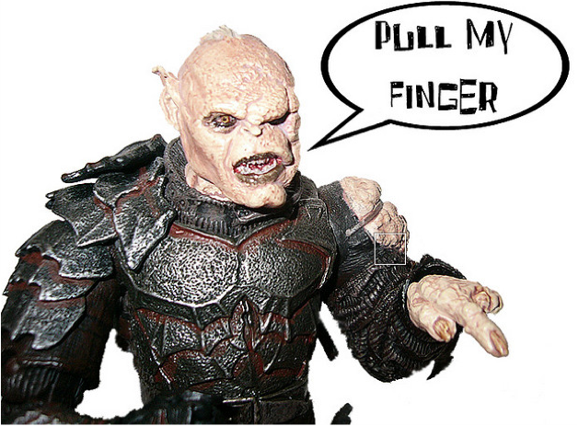
Initial attempt
public class EyeOfSauron {
public void enemiesDetected() {
int elves = getNumberOfElves();
int hobbits = getNumberOfHobbits();
int dwarves = getNumberOfDwarves();
sauronDisplay.update(elves,hobbits,dwarves);
sarumanDisplay.update(elves,hobbits,dwarves);
}
// other methods
}
what if we want to add this guy???
tasty hobbits!!!
uggghhh!!!
coded to concrete implementation
Human Computer Interaction Research
University of Nevada, Reno

Slide 6
Publisher Subscriber
I’ll keep an eye out
I’m interested
I’m interested
Human Computer Interaction Research
University of Nevada, Reno

Slide 7
Publisher Subscriber
a dwarf and an Elf!!!
update(1,0,1)
update(1,0,1)
Human Computer Interaction Research
University of Nevada, Reno

Slide 8
Publisher Subscriber
boohooo ;-(
unsubscribe!!
Human Computer Interaction Research
University of Nevada, Reno

Slide 9
Publisher Subscriber
I’ll keep an eye out
I better get
some help
subscribe!!
Human Computer Interaction Research
University of Nevada, Reno

Slide 10
Publisher Subscriber
uh oh!!!
update(100k,99k,2)
update(100k,99k,2)
Human Computer Interaction Research
University of Nevada, Reno

Slide 11
Solution
The Observer Pattern defines a one to many dependency between objects so that when one object changes state, all of its dependents are notified and updated automatically.
Human Computer Interaction Research
University of Nevada, Reno

Slide 12
How it was
objects know all about each other
Human Computer Interaction Research
University of Nevada, Reno

Slide 13
Design Principle
Strive for Loosely coupled designs between objects that interact
Human Computer Interaction Research
University of Nevada, Reno

Slide 14
Class Diagram
add new observer don’t need to modify subject
new observers can be added runtime
independence
Subject only knows that Observer implements Observer Interface
easily reuse subjects or observers
Human Computer Interaction Research
University of Nevada, Reno

Slide 15
Interfaces
public interface Subject {
public void registerObserver(Observer o);
public void removeObserver(Observer o);
public void notifyObservers();
}
public interface Observer {
public void update(int elves, int dwarves, int hobbits);
}
Specific information
Human Computer Interaction Research
University of Nevada, Reno

Slide 16
Concrete Subject
public class EyeOfSauron implements Subject{
private ArrayList observers;
private int elves;
private int hobbits;
private int dwarves;
public EyeOfSauron(){
observers = new ArrayList();
}
public void enemiesDetected() {
notifyObservers();
}
public void notifyObservers() {
for (int i=0; i< observers.size(); i++) {
Observer observer = (Observer) observers.get(i);
observer.update(elves,hobbits,dwarves);
}
}
Human Computer Interaction Research
University of Nevada, Reno

Slide 17
Concrete Subject
public void setEnemies(int elves, int dwarves, int hobbits) {
this.elves=elves;
this.dwarves=dwarves;
this.hobbits=hobbits;
enemiesDetected();
}
public void registerObserver(Observer o) {
observers.add(o);
}
public void removeObserver(Observer o) {
int i = observers.indexOf(o);
if (i >=0) {
observers.remove(i);
}
}
Human Computer Interaction Research
University of Nevada, Reno

Slide 18
Concrete Observer
public class SarumanDisplay implements Observer {
private int elves;
private int hobbits;
private int dwarves;
private String name;
private Subject eyeData;
public SarumanDisplay (Subject eye, String name) {
this.eyeData=eye;
this.name=name;
eyeData.registerObserver(this);
}
public void update(int elves, int dwarves, int hobbits) {
this.elves=elves;
this.dwarves=dwarves;
this.hobbits=hobbits;
System.out.println(name+ " Display update");
display();
}
Human Computer Interaction Research
University of Nevada, Reno

Slide 19
Concrete Observer
public void display(){
System.out.println(name + " sees:" + elves+" elves and " + dwarves +" dwarves and " + hobbits + " hobbits");
}
public void loseInterest() {
eyeData.removeObserver(this);
System.out.println(“remove Observer”);
}
Human Computer Interaction Research
University of Nevada, Reno

Slide 20
Test App.
public class TestSauronEye {
public static void main(String[] args) {
EyeOfSauron eye = new EyeOfSauron();
SarumanDisplay sarumanDisplay = new SarumanDisplay(eye,”Saruman Display”);
SauronDisplay sauronDisplay = new SauronDisplay(eye,”Sauron Display”);
eye.setEnemies(1, 1, 2);
sauronDisplay.loseInterest();
eye.setEnemies(4, 2, 2);
}
}
bin $java TestSauronEye
Saruman Display sees: 1 elves and 2 dwarves and 1 hobbit
Sauron Display sees: 1 elves and 2 dwarves and 1 hobbit
Remove Observer
Saruman Display sees: 4 elves and 2 dwarves and 2 hobbit
Human Computer Interaction Research
University of Nevada, Reno

Slide 21
Observer Class Diagram
Human Computer Interaction Research
University of Nevada, Reno

Slide 22
disadvantages of Push
2 hobbits, 20 dwarves, 40 elves, 1 ent, 1 wizard
update(2,20,40,1,1)
fat interface
update(2,20,40,1,1)
ents?
not every observer needs all the data
Human Computer Interaction Research
University of Nevada, Reno

Slide 23
Push vs Pull
- All the data gets pushed all the time
+ every observer has all the latest data
- May need multiple calls to get all the data
+ more flexibility let observers figure it out themselves
Human Computer Interaction Research
University of Nevada, Reno

Slide 24
Java Observable
this is an abstract class
Java does all the work with notifying observers
Observable == Subject
Human Computer Interaction Research
University of Nevada, Reno

Slide 25
Steps
To become an observer
Objects needs to implement observer interface
call addObserver()
For Observable (subject) to send notifications
Extend java.util.Observable
call setChanged()
notifyObservers() or notifyObservers(Object arg)
flag to give you more flexibility
pull
push
Human Computer Interaction Research
University of Nevada, Reno

Slide 26
Steps
For observer to receive notifications
update method looks different
update(Observable o, Object arg)
instead of pushing all data, now just receive a reference to the updated object and use getters to PULL your information
Alternatively use arg to PUSH all your data
public void update(Observable o, Object arg)
if (o instanceof SubjectClass) {
SubjectClass data = o;
this.property = data.getProperty();
display();
}
}
public class SubjectClass extends Observable {
private Type property;
public Type getProperty() {
return property
}
}
Human Computer Interaction Research
University of Nevada, Reno

Slide 27
Limitations
Observable is class not interface
Can’t use multiple inheritance
Setchanged is protected
you must subclass to be able to call it.
violates favor composition over inheritance
Order in which Observers are updated may differ from Roll your own implementation
Alternatively …..roll your own
Human Computer Interaction Research
University of Nevada, Reno

